Slide 1

CENTER FOR YOGA - SRMIST
UNIT - 2
SESSION - 3
BRAIN FUNCTIONS / BIO MAGNETISM AND MIND COGNITION

Slide 2
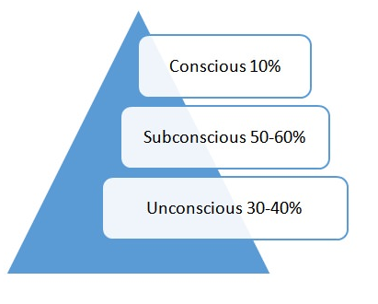
The 3 Levels of Consciousness
Conscious Mind:
The conscious mind consists of what we are aware of at any given point in time. It includes the
things that we are thinking about right now, whether it’s in the front of our minds or the back.
If we’re aware of it, then it is in the conscious mind. Robert Collier explained the conscious
mind expertly when he said, “It is only through your conscious mind that you can reach the
subconscious. Your conscious mind is the porter at the door, the watchman at the gate. It is to
the conscious mind that the subconscious looks for all its impressions.”
Unconscious Mind:
The final level of consciousness is known as the unconscious. This is made up of thoughts, memories, and primitive/instinctual desires that are buried deep within ourselves, far below our conscious awareness. Even though we’re not aware of their existence, they have a significant influence on our behavior.

Slide 3
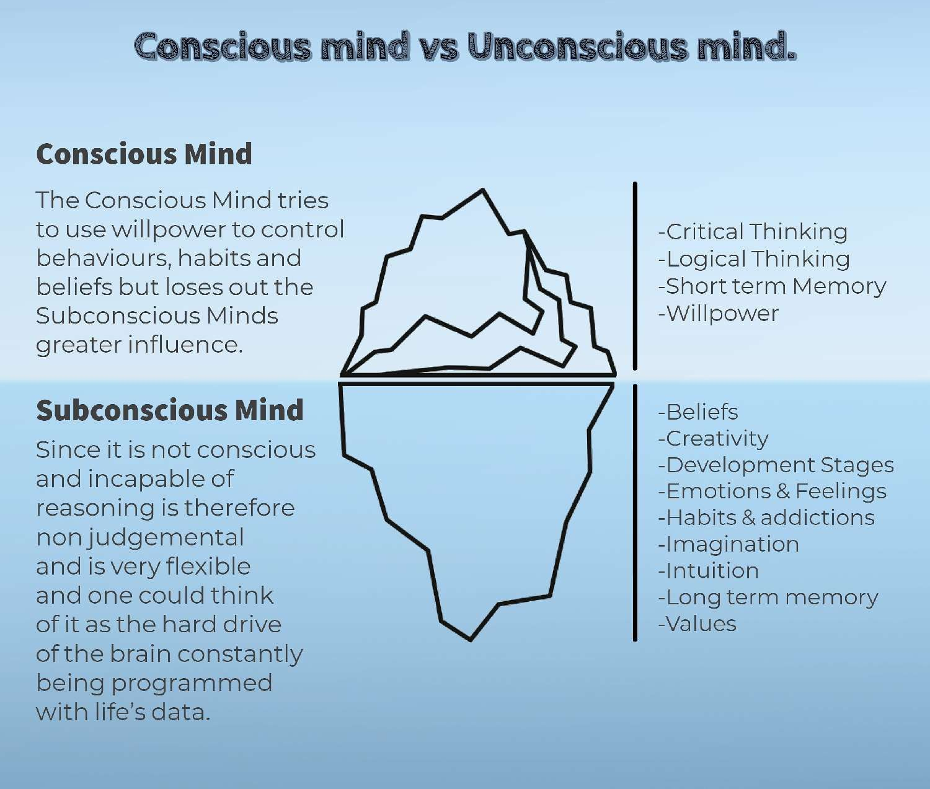
The 3 Levels of Consciousness
Subconscious Mind:
The next level of consciousness, the subconscious (or preconscious), is the stuff from
which dreams are made. We can consider it as the storehouse of all remembered
experiences, impressions that are left on the mind by such experiences, and
tendencies that are awakened or reinforced by these impressions. Every experience
you’ve ever had, every thought, every impression lives in the subconscious mind and
influences our patterns of thought and behavior far more than we realize. The
subconscious holds information that is just below the surface of awareness. An individual
can retrieve such information with relative ease, and we usually refer to these as
memories.
Take Away: This is important than the other 2 levels because the brain operates in the state of alpha waves and it is highly receptive, Whatever you feed at this state, good or bad it become a reality. Hence it is very important to feed good and positive thoughts when you are in Sub-Conscious state. [Yogic Training – Yoga Nidra]

Slide 4
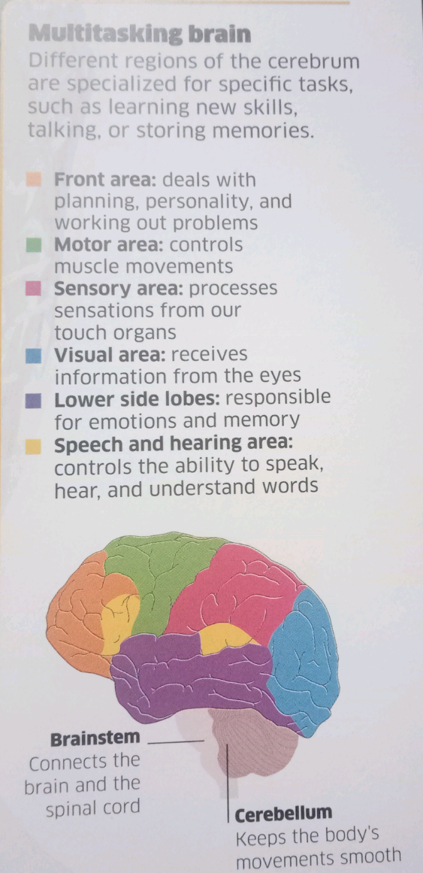
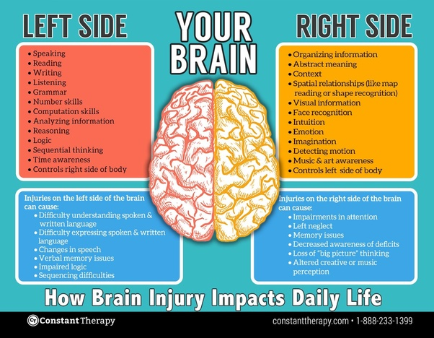
Brain and its Functions

Slide 5
Bio Magnetism and Its Operation
What is Bio Magnetism.?
It is nothing but the phenomenon of magnetic fields produced by living organisms;
Can you Explain Further.?
In and around every cell infinitesimally tiny particles are circulating, each of which keeps rotating about itself. Due to this self-rotation a “centrifugal force” is generated. This particle is called the “life-force”. On account of this self-rotation a “spreading wave” is given rise to, from the life-force and it spreads throughout the body. Collectively this wave is called “bio-magnetism”. This is the main fuel for all the metabolic routines of the physical body. A small portion of this wave is released through the sense-organs – skin, ears, eyes, nose and tongue – after being converted into pressure, sound, light, smell and taste. This spreading wave of the life-force is called “biomagnetism” or “human-magnetism”. The bio-magnetism is that which energizes all cells and tissues.

Slide 6
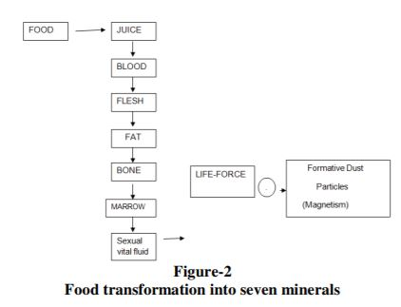
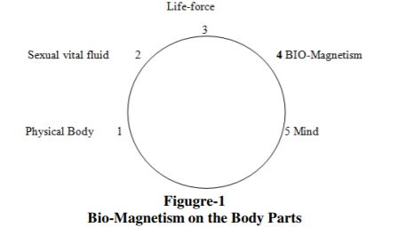
Bio Magnetic Operation and Food Transformation
Food-Transformation in to Seven Minerals: The food one eats through metabolism gets converted into seven essential minerals. They are juice, blood, flesh, fat, bone, bone marrow, and sexual vital fluid.
The food intake gets digested and all mineral became a juicy substance. It is absorbed by the small intestine.
The juice along with some acid became blood.
A part of blood became flesh.
Fat gets separated from fat and became bone.
Calcium gets separated from fat and becomes bone.
After becoming bone the rest of the juice became bone marrow.
Bone marrow is the origin of the sexual vital fluid.
It is the source which produces life force particles and these lifeforce particles liberate dust particles as bio-magnetism. This life-force particle circulates throughout the physical boy and energizes all the cells and tissues.

Slide 7
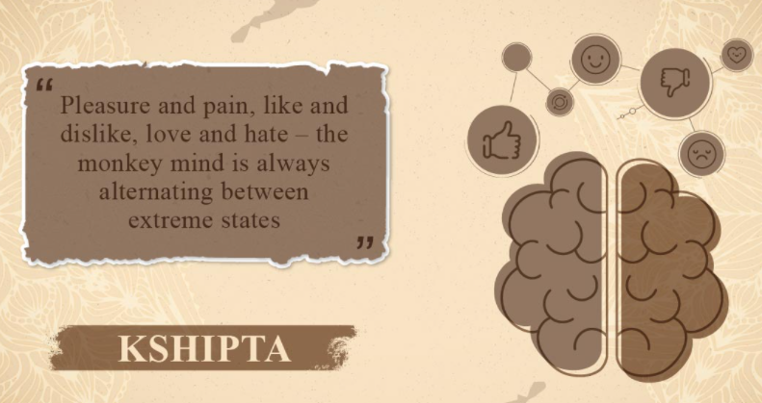
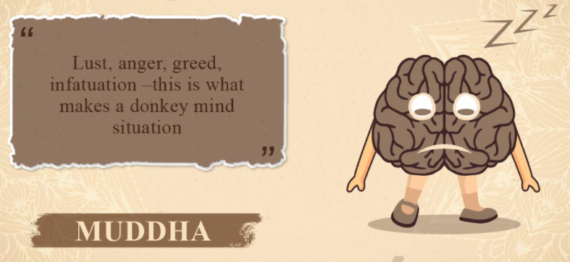


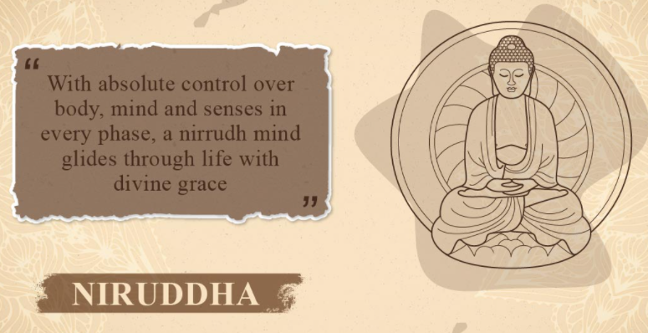
States Of Mind As Per Sankhyan Philosophy
Distracted Dull Partially Focussed
Concentrated (One Pointed) Fully Concentrated(Pure Consciousness)

Slide 8
Meditation and Brain Waves [EEG]
Gamma (32-100Hz) | High Problem solving, Peak Performance, Learning
Beta (13-32Hz) | Normal Problem solving, Excitement, Alert conscious, Normal Awake
Alpha (8-13Hz) | Relaxed, Starting stage of meditation, Calm
Theta (4-8Hz) | Deep Dream, Meditation
Delta (0.5-4Hz) | Dreamless, Deep Meditation

Slide 9
The End

